Slide 1
Week 3, Class 5 Integer Programming

Slide 2

Integer Programming
Integer Programming is related to Linear Programming
Linear objective and constraints (like LP)
Added restriction that some or all of the variables must be integer
Goes by different names (don’t count on these being consistent):
MIP (Mixed Integer Program)- most common. The “mixed” refers to having both integer and continuous variables. Although MIP is used when it is a all integer.
MILP– mixed integer and linear. Or, IP– all integer.
Confusingly, LP– people not in the field may just know Linear Programming and not care about the details of integer constraints.

Slide 3
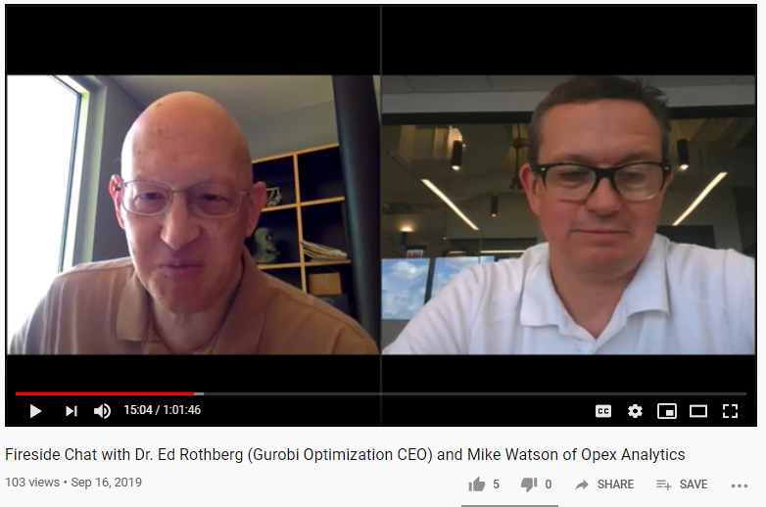
I asked Ed Rothberg if anyone used LP’s. He said “No” (I would have thought someone did!!)

Slide 4


Why Our Warnings about Integer Programming?
Adding integer variables slows down your models (so do it deliberately)
By extension, adding integer variables, means your models have to be smaller

Slide 5
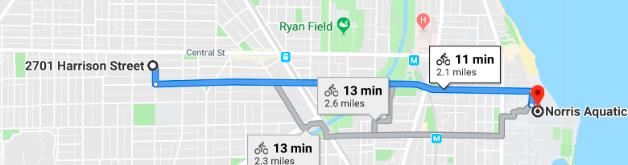
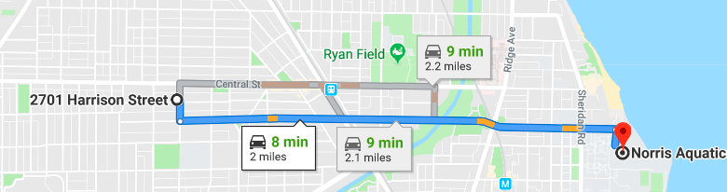
“Slower” -- people think of this….

Slide 6
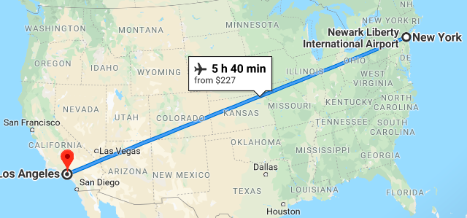
“Slower” -- We want you to think this…

Slide 7

“Slower” -- We want you to think this…
155,000 hours
~17 years
(double or triple this b/c that assumes 24x7)

Slide 8
Complexity Theory (Way oversimplified, this is for another class)
Oversimplified View: There are two basic types of optimization problems P and NP-Complete
Class P problems are those where there is a known polynomial time algorithm for solving it
Polynomial time algorithm runs in O(n²); O(n³), O(1), O(n log(n))
For example, if an there is an O(n²) algorithm that takes 20 minutes and n =100, if you double the size the problem (n = 200), the algorithm could take 80 minutes to run (100² = 10,000 and 200² is 40,000).
Class NP-Complete problems are those problems whose optimal solutions can be verified in polynomial time. However, the run-times for algorithms are typically non-polynomial
Non polynomial algorithms are not fast: O(2^{n}); O(n^{n}); O(n!)
For example, if an there is an O(2^{n}) algorithm that takes 20 minutes (n=100), if you double the size the problem, the algorithm could take 10³⁰X times longer. (Hence the problem!)

Slide 9
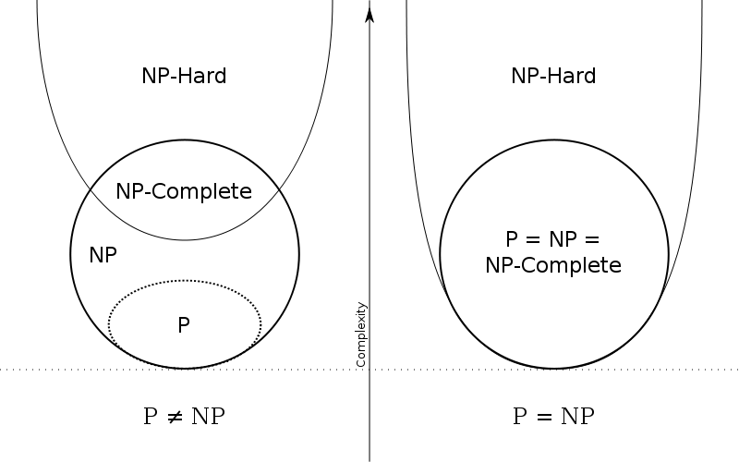
Complexity Theory
This side is the most likely case…
… it is possible, but doesn’t seem likely that someone will prove this…
MIPs are here. This doesn’t mean impossible- it just means you’ll hit the limits sooner than you’d like
LPs in practice run like they are in P
Source: Wikipedia

Slide 10
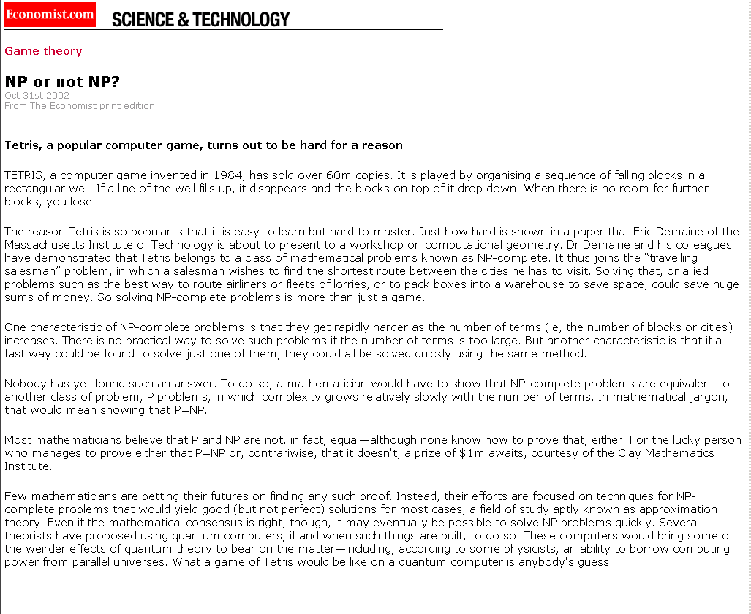

Slide 11
$1million prize for someone who can find a polynomial time algorithm for integer programs

Slide 12
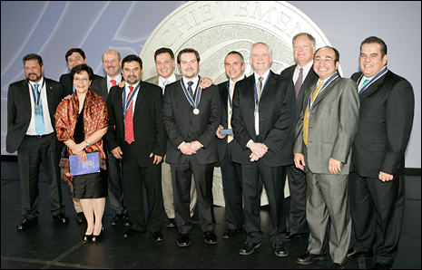
Indeval and $25 Million

Slide 13

A Warning about Our Warning
“If you ask me, I'll go in a different direction honestly based on what I learn from some Q/A on OR Stack Exchange, Gurobi's support team, or my experience.
I trust Gurobi now more than myself.”

Slide 14
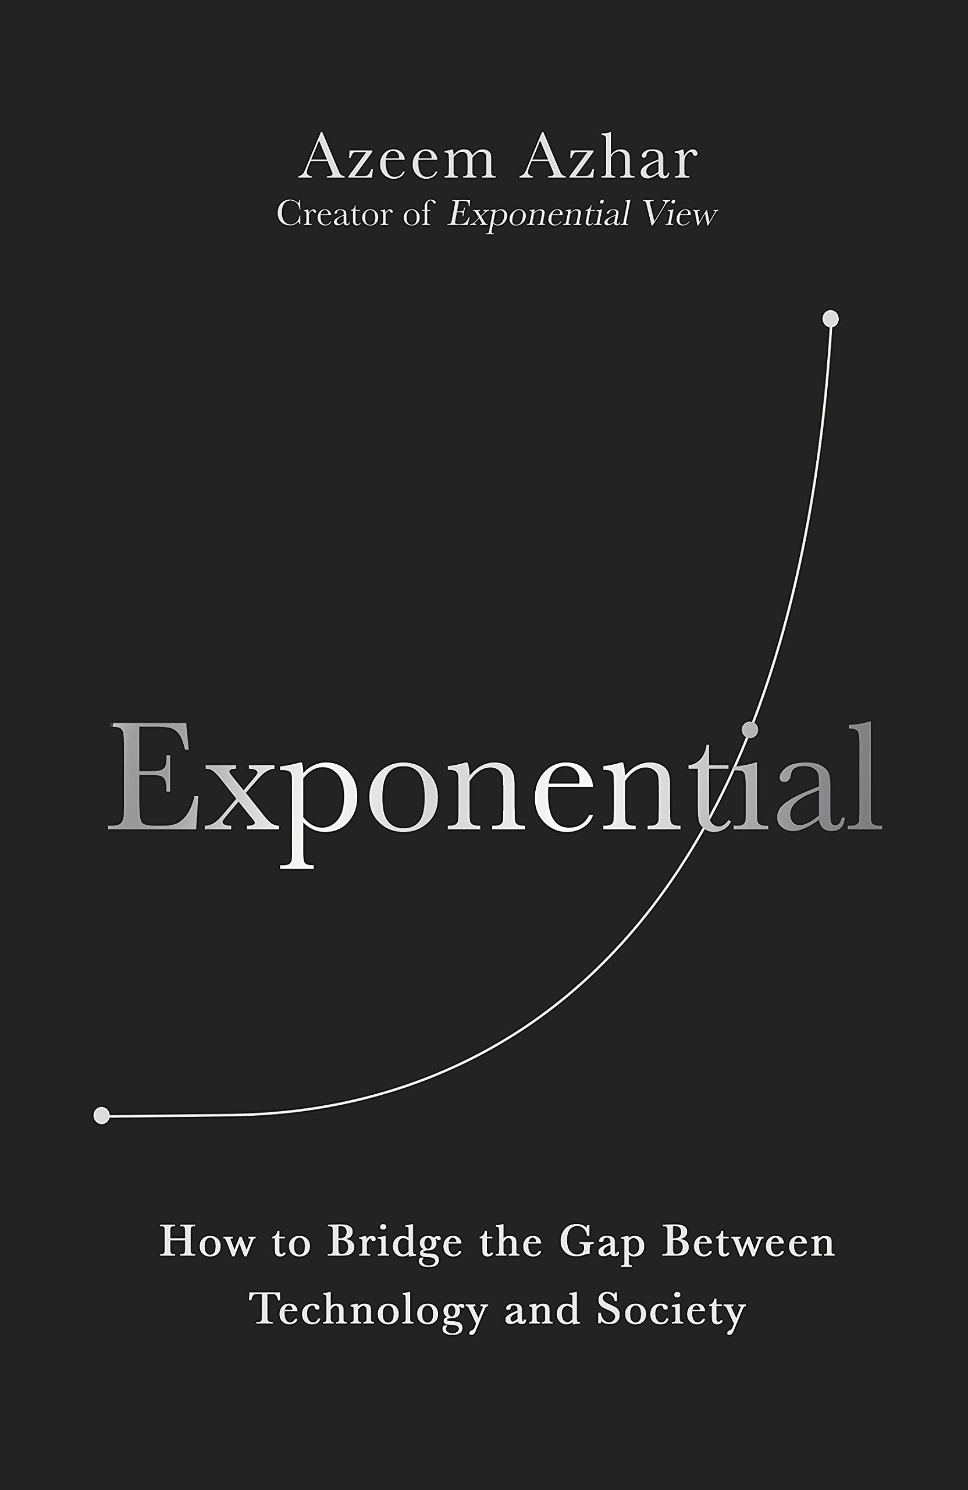
A Warning about Our Warning
What’s Changed?
Solver speed-ups are improving exponentially.
This book does a great job at highlighting exponential changes- they happen faster than our intuition and open up new opportunities.
We might have hit a tipping point.
Now?
A few years ago

Slide 15
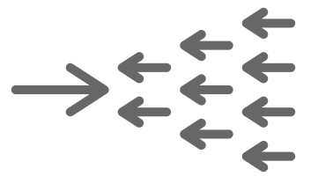
A Warning about Our Warning
What does us mean for us?
New Advice
Old Advice
Gurobi (and maybe CPLEX and FICO Solver) have gotten faster– compare the run-time of your integer variables with the continuous version to see if the difference is OK.
Let Gurobi take care of the hard stuff
Avoid Integer Programming as much as you can.
It is NP-Complete
It will run slow. Sometimes very slow

Slide 16
A Warning about Our Warning
What does us mean for us?
New Advice
Old Advice
Better Advice
Some integer programs will solve very fast– test. (And, some always have.)
The new advice applies to Gurobi, open source solvers will be a lot less robust.
Some integer programs, even in Gurobi, will still be slow (but maybe not for long!)
Gurobi (and maybe CLEX and FICO Solver) have gotten faster– compare the run-time of your integer variables with the continuous version to see if the difference is OK.
Let Gurobi take care of hard stuff
Avoid Integer Programming as much as you can.
It is NP-Complete
It will run slow. Sometimes very slow

Slide 17

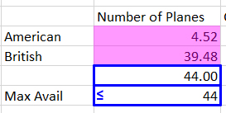
Three Cases for Integer Variables:
Case 1: Discrete Items
Cutting Stock Problem
Berlin Airplane Problem
In general, anytime you need a discrete amount made / bought / moved
Seems like the most obvious. It is the least important. Don’t do this lightly. And, maybe don’t ever do it (But, see warning about warning section)

Slide 18
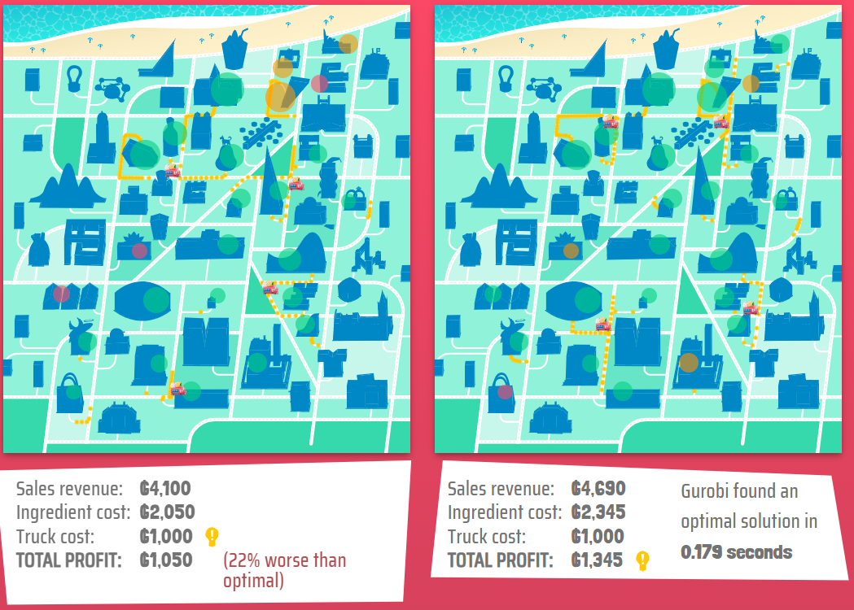

Three Cases for Integer Variables:
Case 2: Binary for Yes/No; Use/Not Use; Open/Close; Assign / Not Assign
Q: What are the two binary variables
Q: Why don’t we need integer variable for number of trucks?
A: The Objective Function takes care of it (and the above x variable)
These are used in almost all models!

Slide 19
Case 2: linking the x and y variables is like an if-then statement
You have a resource: x_{i} (can be 0 or 1 – use it or not)
You may want to use that resource for something, say j: y_{i,j} (also 0 or 1, do you use that resource for this task)
If you want to use i for task j (y_{i,j} ), that is y_{i,j}=1
Then, the corresponding x_{i} = 1
In Algebraic Notation: x_{i} ≥ y_{i,j}
So, if y_{i,j} = 1, then you have to make x_{i} =1
if y_{i,j} = 0, then x_{i} can be 0 or 1
This does the if-then work for you

Slide 20

Three Cases for Integer Variables:
Case 3: Binary for Logic: powerful if-then; And; Or
In the Steel Slab problem, we’ll need to use binary to say Group1 is used before Group2
These are very powerful, but we will leave this for later in the class

Slide 21
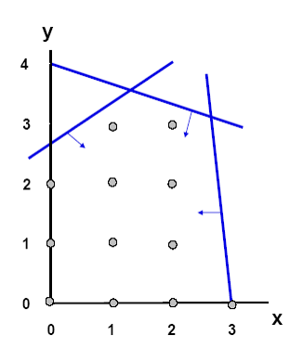
Difficulty in Solving IPs: The Geometry
Feasible region is a set of discrete points
Unlike in Linear Programming, we don’t have a systematic way to find any of these points.
Insight: Solving a relaxed Linear Program may help us– especially if we can add constraints that touch the discrete points

Slide 22
Approaches to Solving IPs
Lucky Approach-- Automatic Formulations: solve the continuous linear version and you get all integers for your variables. This worked for the assignment / transportation problem. Even those problems can fail fast when the data isn’t integer or you add constraints. Don’t count on being lucky.
Hard Work Approach-- Specialized Optimization Based Heuristics and Heuristics. You need to tailor the algorithm to the problem. Only worth it if the problem is important enough. Many are… we’ll touch on this later
Round LP’s: Let rounding be your friend, for some variables
General Algorithms: This is the big and general one– it is what all solvers use. The technique is branch and bound. We’ll spend time on this

Slide 23
Rounding
Approach: Set the variables to continuous and solve.
After the solve, either ignore the non-integer or round it to test the feasibility
When to ignore: Use 262.5 rolls (cutting stock), Make 1,653,300.8 boxes of Mac ‘N Cheese
When to test: Berlin Airplane– test different combinations of rounding up or down.
A rule of thumb: When dealing with big quantities, simple rounding is usually fine– the underlying data may not be as precise as the error for rounding
Reverse of the rule of thumb: Don’t set a variable to integer just to see nice round numbers– do it purposefully. (This is what formatting is for in Python and Excel)
Warning about the Warning: Maybe Gurobi has hit a point where you can let it do the work for you– but test first and test with a lot of different data.

Slide 24
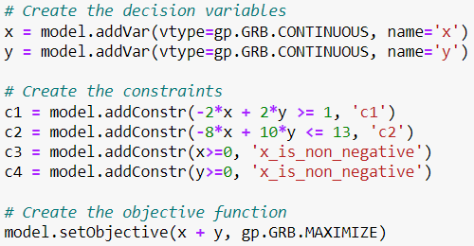
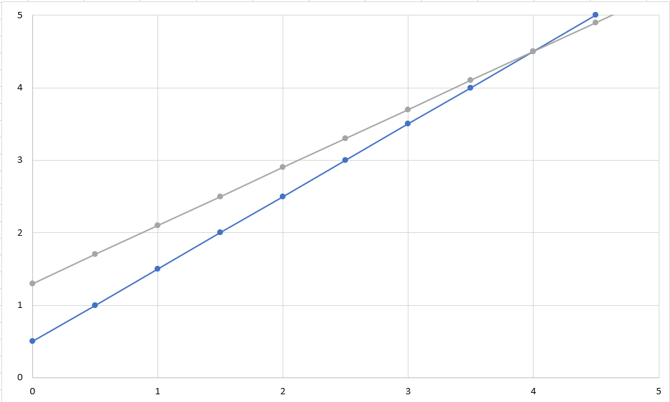
Rounding: When making quantities of things, the counter examples are contrived (Don’t worry about these as much)
Relaxed is x = 4, y =4.5
Integer is x = 1, y = 2
These examples are possible, not likely

Slide 25

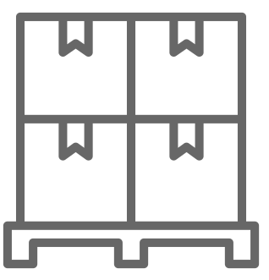
Rounding with Binary Decisions Fails Fast
You have some trucks available to you (trucks = bins)
The truck have a capacity of 45,000 lbs
Let x_{i} = 1 if the truck is used, 0 otherwise
So, x_{i} is a binary variable that can equal either 0 or 1
You have a set of loads to put onto the trucks
Let w_{j} = the weight of item j in the list of loads
Let y_{i,j} = 1 if load j is assigned to truck I
So, y_{i,j} is also a binary variable
Objective
Minimize the number of trucks
Constraints needed to make the optimization work
We cannot put more than 45,000 lbs in a truck
We need to move all the loads
If you put an item on a truck, you need to make sure you use that truck
See Model

Slide 26
Branch and Bound
Motivation: Branch and Bound is
the most efficient technique known for solving general IP’s
used in all solvers.
We can get some intuition by understanding this
Basic Approach
1. Solve LP
2. Observe violations of integrality
3. Add constraints to rule out non-integer solution
4 Solve new LPs and continue until an integer solution is produced
5. Prove integer solution is best by implicitly enumerating all integer solutions.

Slide 27
Branch and Bound
Key Observations:
Adding constraints to an LP can only make the solution worse. (This is true in general and something to keep in mind)
If an LP has a worse solution than an incumbent integer solution then it can never lead to a better integer solution.
Branches of the tree can be fathomed (not explored, and thus not having to enumerate) through this observation.

Slide 28
Branch and Bound Example
Problem: Find the product mix that maximizes profit, where
Formulation:

Slide 29
Graphical Display of B&B Example
x₁ ≥4
x₁ ≤3
x₂ ≥2
x₂ ≤1
x₁ ≥5
x₁ ≤4
Z = 40
Z = 37

Slide 30
Back Up (if you want to do the exercise) Branch and Bound Example
Algorithm:
Step 1: Solve Subproblem 1 (LP relaxation)
Either
constraint
will rule out
X₁=3.75
Step 2: Solve
Subproblem 2: Subproblem 1 plus constraint
Subproblem 3: Subproblem 1 plus constraint
Step 3: Solve
Subproblem 4: Subproblem 2 plus constraint
- infeasible
Subproblem 5: Subproblem 2 plus constraint

Slide 31
Back Up (if you want to do the exercise) Branch and Bound Example
Step 4: Solve
Subproblem 6: Subproblem 5 plus constraint
Subproblem 7: Subproblem 5 plus constraint
Step 5: Solve
Subproblem 3: Subproblem 1 plus constraint

Slide 32

Branch and Bound Stopping Conditions
What do you think some stopping conditions may be?
You have successfully explored every logical branch
Only likely for small problems
You set a time limit, and use the best solution you’ve found so far
You have a feasible solution within a certain gap
Go to Berlin “Bug”

Slide 33
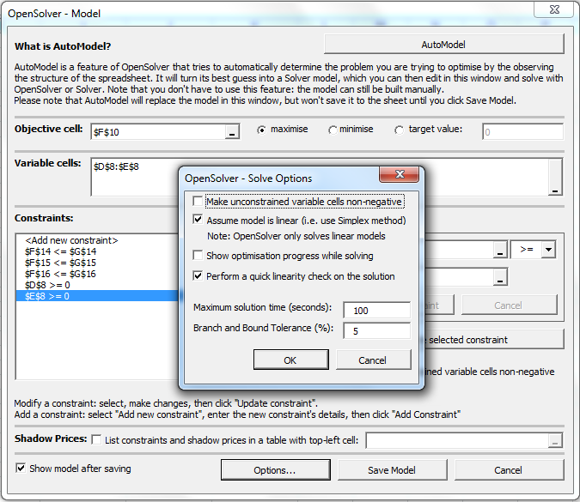
Branch and Bound Stopping Conditions in OpenSolver

Slide 34
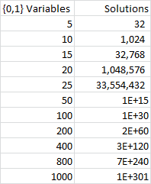
Implications of Branch and Bound
Speed: B&B is much slower than LP
B&B uses LP as a subroutine
number of nodes in B&B tree grows exponentially with size of problem (e.g., a problem with n {0,1} integer variables has 2^{n} possible solutions)
maximum size IP we can solve is much smaller than maximum size LP we can solve (e.g. millions of variables)
But, solvers like Gurobi are good at exploring the trees
Sensitivity Analysis: IP’s don’t yield sensitivity data
solutions can change discontinuously
no way to compute dual prices

Slide 35
Revisit Kidney Problem

Slide 36

New York Times Article from January 2012: 60-Person Kidney Swap!

Slide 37
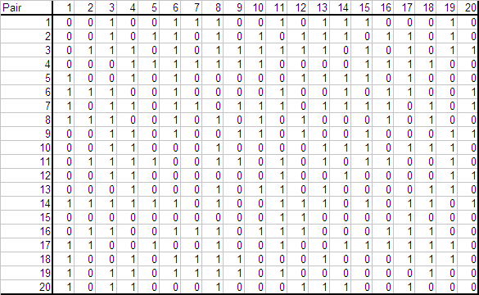
Kidney Swaps– example of integer program
C_{i,j} – compatibility matrix (could have scores), = 1 if patient i can receive from donor j

Slide 38
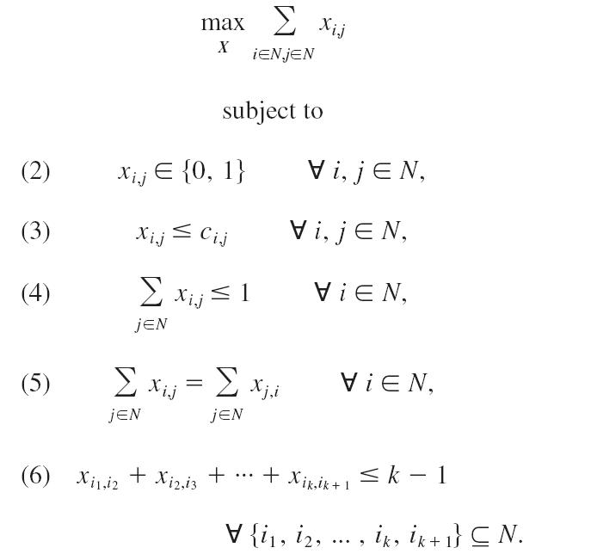
Kidney Swap Problem Formulation
Maximizes the number of transplants (or value)
Either i gets a kidney from j or doesn’t
i can get a kidney from j only if compatible
i gets at most 1 kidney
If i gets a kidney from j, then j has to get a kidney, too
Limits the size of the chain. Why would you want this?
This constraint size grows quickly. It is for every permutation.
Netherlands– 4 times a year. US Alliance wants more frequent. Trading off pool size and quality vs longer waits for patients.
How often would you run this?–
.
How big should the pool be?.
If a pair was a match, why would they join the pool?
Who helps make exchanges better?
As big as possible
To find a better match, to help hard-to-match people.
Altruistic donors

Slide 39

Kidney Swaps (like the residency matching)
He said that with all the side constraints, the problem is too hard for his algorithms. Integer programming is the way these problems are solved. He called Integer Programming “magic”
He had a good illustration of why altruist donors help build chains (which can provide better solutions)
Donor A
Donor B
Donor C
I heard a talk from Alvin Roth. He won a Nobel Prize for this type of work. (And, medical residency and school assignments)
Recpt B
Recpt C
Key condition is market stability– no one can gain from a trade (source). (After doing the matching, no doctor or hospital are better off by agreeing to work together and ignoring the match they each got.
If someone backs out, the remaining pairs are intact.
Some big hospitals do their own exchanges– which makes it harder for hard-to-match people in smaller areas. He is trying to create some kind of “frequent flyer” program to encourage participation.
Fun fact: he still has to work hard to sell the idea.

Slide 40
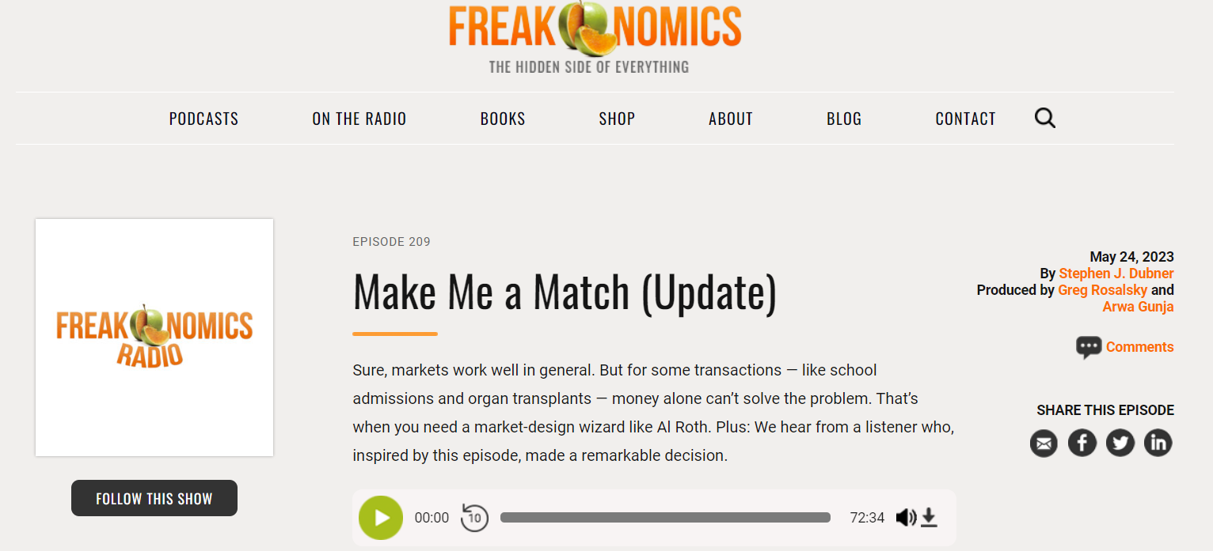
This podcast is a high-level of what we covered and the benefit of altruistic donors.

Slide 41
End of Section

